Slide 1
Chapter 3
Service Area Competitor Analysis
HCA 442

Slide 2
The Strategic Planning Process
Strategic Planning
Situation Analysis
External Analysis Internal Analysis Directional Strategies
Strategy Formulation
Directional Strategies
Adaptive Strategies
Market Entry/Exit Strategies Competitive Strategies
Planning the Implementation
Service Delivery Strategies Support Strategies
Action Plans

Slide 3
Focus of Service Area Competitor Analysis
Avoid surprises in the marketplace.
Provide a forum for leaders to discuss and evaluate their assumptions about the organization’s capabilities, market position, and competition.
Make everyone aware of significant and formidable competitors to whom the organization must respond.
Help the organization learn from rivals through benchmarking (specific measures comparing the organization with its competitors on a set of key variables).

Slide 4
Focus of Service Area Competitor Analysis
Build consensus among executives on the organization’s goals and capabilities, thus increasing their commitment to the chosen strategy.
Foster strategic thinking throughout the organization. Identify market niches and discontinuities.
Select a viable strategy.
Contribute to the successful implementation of the strategy.
Anticipate competitors’ moves.
Shorten the time required to respond (countermoves) to a competitor’s moves.

Slide 5
Obstacles to Effective Service Area Competitor Analysis
Misjudging industry and service area boundaries Poor identification of the competition Overemphasis on competitors’ visible competence
Overemphasis on where, rather than how, to compete
Faulty assumptions about the competition
Paralysis by analysis

Slide 6




Service Area Competitor Analysis
Step 1 – Complete Situational Analysis of the General Environment, Health Care Industry, and Service Area
Step 2 – Conduct Service Area Structure Analysis
Step 3 – Conduct Competitor Analysis
Step 4 – Analyze the Critical Success Factors
Step 5 – Map Strategic Groups
Step 6 – Assess Likely Competitor Actions or Responses
Step 7 – Synthesize Analyses

Slide 7

Services Analysis – Five Forces that Indicate the Viability of a Product or Service
Potential Entrants
Threat of New Entrants
Bargaining Power of Suppliers
Bargaining Power of Buyers
Suppliers
Rivalry
Buyers
Rivalry Among Existing Competitors
Threat of Substitute Products or Services
Substitutes

Slide 8
Service Area Structural Analysis
Porter’s Five Forces
Threat of new entrants to the market
Level of rivalry among existing organizations
Threat of substitute products and services
Bargaining power of buyers (customers)
Bargaining power of suppliers

Slide 9
Barriers to Entry
Existing organizations have economies of scale
High volume, lower costs.
Existing product or service differentiation
It costs a great deal (capital) to get into this type of business
Switching from one service provider to another is expensive
Exclusive access to distribution channels
Current service providers have developed cost advantages independent of scale
There are government or legal constraints

Slide 10
Intensity of Rivalry
Numerous or equally balanced competitors? Slow market growth for these types of services?
High fixed costs (buildings, equipment)?
Competitors’ products or services are pretty much the same? Switching from one service provider to another is easy?
Difficult to leave the business once in it?
Competitors place great importance on achieving success?

Slide 11
Threats of Substitute Services
Many services available that perform about the same function
There are lower cost substitute services
Buyers of the service tend to experiment or substitute often
Buyers of the service have difficulty in telling the difference in the effectiveness of the alternatives

Slide 12
Bargaining Power of Buyers
Buyers of the service purchase in large volume or concentrates purchases Purchases products that are standard
Buyers view all providers as having about the same service and quality?
Buyers have low switching costs in changing to another provider
Buyers have low profitability or narrow margins
Pose a threat of backward integration
Buyers could begin providing the service themselves?
Buyers has low quality requirements
Has enough information to gain bargaining leverage

Slide 13
Bargaining Power of Suppliers
Few suppliers (personnel, equipment, materials) Few substitutes for the supplies
The supplier’s products or services are unique
The product or service supplied is important to the buyer’s business Switching costs from one supplier to another are high
The buyer’s industry is not considered an important customer The suppliers pose a threat of forward integration

Slide 14
Favorable Forces
If all five forces are fav orable: Little or friendly competition
Difficult for new competitors to enter the business
Few or no good substitutes for the product or service Buyers will not control the price, quality, design, or volume Suppliers will not control the inputs to production

Slide 15
Unfavorable Forces
If all five forces are unfav orable:
A great deal or very unfriendly competition
Easy for new competitors to enter the business Many good substitutes for the product or service
Buyers will control the price, quality, design, or volume Suppliers will control the inputs to production

Slide 16
Services Analysis
A “Three Star” Product or Service
Potential Entrants
Threat of New Entrants
Bargaining Power of Suppliers
Bargaining Power of Buyers
Suppliers
Rivalry
Buyers
Rivalry Among Existing Competitors
Threat of Substitute Products or Services
Substitutes

Slide 17

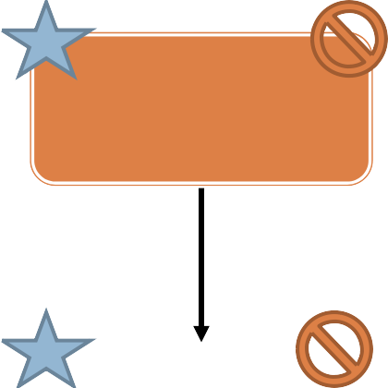



Services Analysis
Evolving Products/Services Viability
Potential Entrants
Threat of New Entrants
Bargaining Power of Suppliers
Bargaining Power of Buyers
Buyers
Suppliers
Rivalry
Rivalry Among Existing Competitors
Threat of
Substitutes
Substitute Products or Services

Slide 18
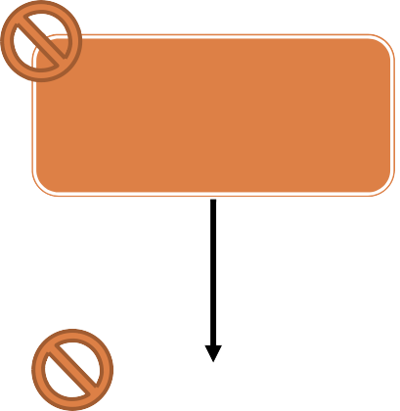
Services Analysis
Evolving Products/Services Viability
Potential Entrants
Threat of New Entrants
Bargaining Power of Suppliers
Bargaining Power of Buyers
Buyers
Suppliers
Rivalry
Rivalry Among Existing Competitors
Threat of
Substitutes
Substitute Products or Services

Slide 19
Services Analysis
Evolving Products/Services Viability
New Regulations or Political Changes
New Technologies or Services Improvement
Social or Demographic Changes
Economic Changes
Competitive Changes

Slide 20
Competitor Analysis & Strategic Groups
What are the strengths and weaknesses of your
competitors?
Can your competitors be “mapped” with respect to two or more dimensions?

Slide 21
Competitor Analysis and Mapping Strategic Groups
Competitor Strengths and Weaknesses
Service Category Critical Success Factor Analysis

Slide 22
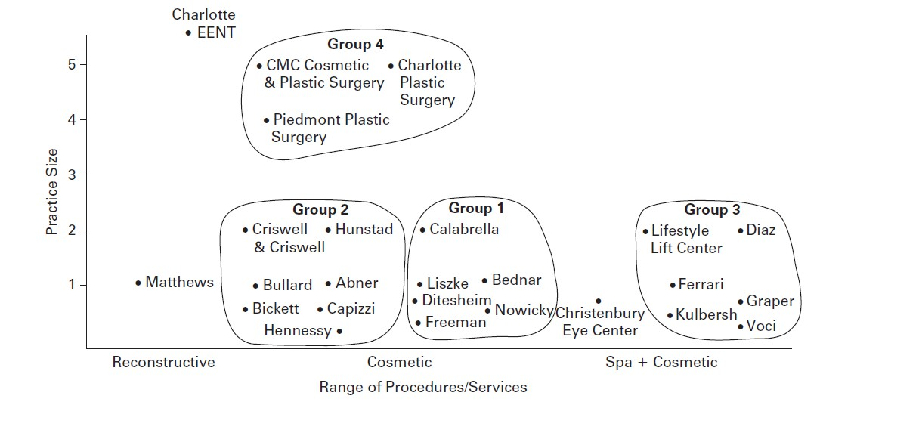
Service Area Plastic Surgery Competitors (2012)
For the Charlotte service area, a majority of the plastic surgery practices are pursuing one of four basic strategies and, for the most part, do not engage in between- group competition.
Strategic groups one and two have some overlap; however, physicians in group two engage in Third World country medical missions. There is considerable within- group competition particularly in group three where there is a focus on luxurious surroundings and personal attention. Non board- certified plastic surgeons are not shown on this map.

Slide 23
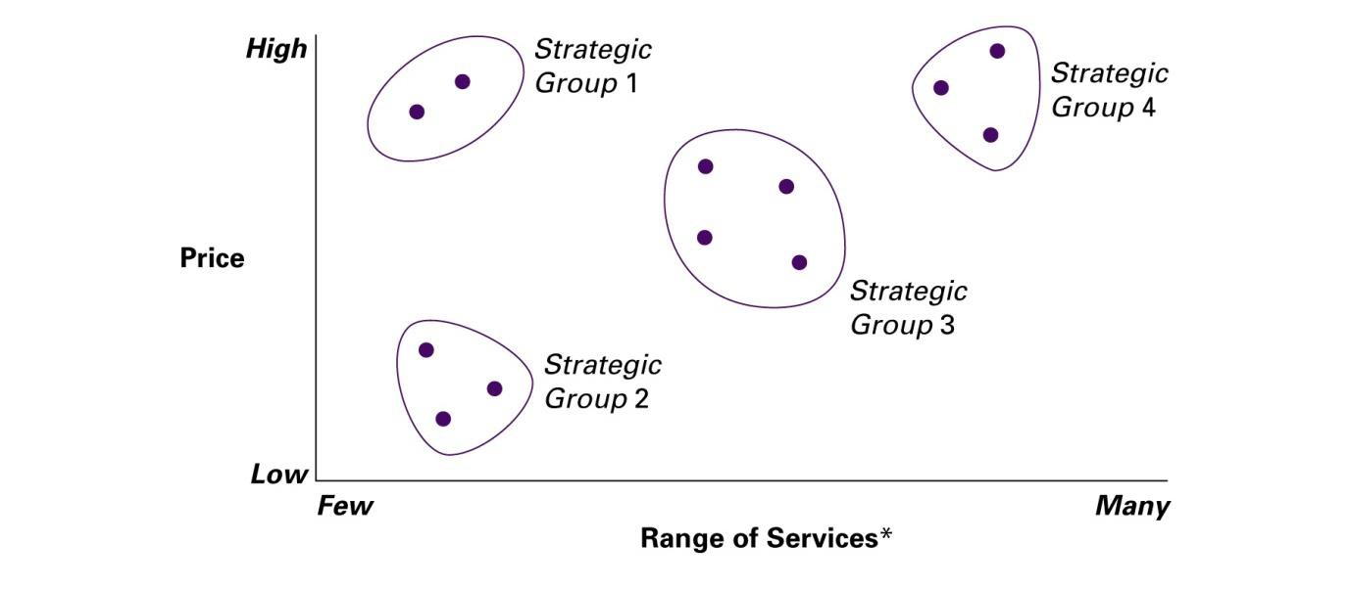
Service Area Assisted-Living Competitors
For this service area, assisted living organizations are pursuing four basic strategies: high price with highly specialized services (Strategic Group 1), low price with few ancillary services (Strategic Group 2), medium price with some (selected) services (Strategic Group 3), and high price with many services (Strategic Group 4). The primary (direct) competitors for these organizations are other organizations within their own strategic group. Customers who seek the attributes of one strategic group, such as highly specialized rehabilitation services, are unlikely to be attracted to another strategic group. These assisted- living organizations should change strategic cautiously as a decision to add services may move an organization to a new strategic group and therefore a new set of competitors. Note that in this example there may be an opportunity to enter or move toward a medium- cost, many services niche and become a strategic group of one.
*Range of services included skilled nursing, organized social activities, outings, physical therapy, education, rehabilitation, speech therapy, Alzheimer’s care, nutritional services, infusion, pharmacy, homemaker services, live- ins, companions, and so on.

Slide 24
Strategic Thinking Questions Validating the Strategic Assumptions
Is the strategy consonant with the competitive environment?
Do we have an honest and accurate appraisal of the competition?
Have we underestimated the competition?
Has the rivalry in the service category/service area changed?
Have the barriers to entering the service category/service area changed?
Does the strategy leave us vulnerable to the power of a few major
customers?

Slide 25
Strategic Thinking Questions Validating the Strategic Assumptions
Has there been any change in the number or attractiveness of substitute products or services?
Is the strategy vulnerable to a successful strategic counterattack by competitors?
Does the strategy follow that of a strong competitor?
Does the strategy pit us against a powerful competitor?
Is our market share sufficient to be competitive and generate an acceptable profit?

Slide 26
Chapter 3 Practical Lessons
Specifying the service category frames the scope of service area competitor analysis. The service category may be defined very broadly such as hospital services or defined very narrowly such as pediatric hematology- oncology, depending on the intent of the strategic planning process.
Generally, competitively relevant issues in the service area will impact the organization more directly than issues in the general environment and broader health care industry except for “game changing” policy shifts or major issues such as large shifts in the economy.
The service area structural analysis reveals the attractiveness of a service category in a service area and provides insight into the desirability of entering the market as well as how best to compete within the market.
The process of mapping competitors on important market dimensions shows which competitors are most similar to the organization and therefore which are most dangerous. Use the critical factors for success for the product category in the service area to map competitors. Those critical factors determine the “winners” and “losers.”

